Slide 1
A multi-view
Auto Lip Reading (ALR)
Team 12. The Kip-reader’s
l
2016.10.10
Jesper Loenbaek
Youngsoo Jang
HyoJung Han

Slide 2
Table of Content
About Lip-reading
Application
Previous Work
Our Approach
Dataset – OULUVS2
Q&A

Slide 3
About Lip-reading
What is Lip-reading?
Understanding speech by visually interpreting movement of lips, face and tongue
Who use it?
Deaf or hear-of-hearing people
People with normal hearing process (McGurk Effect)
Notes:
State : continuous -> discrete (0~499)

Slide 4
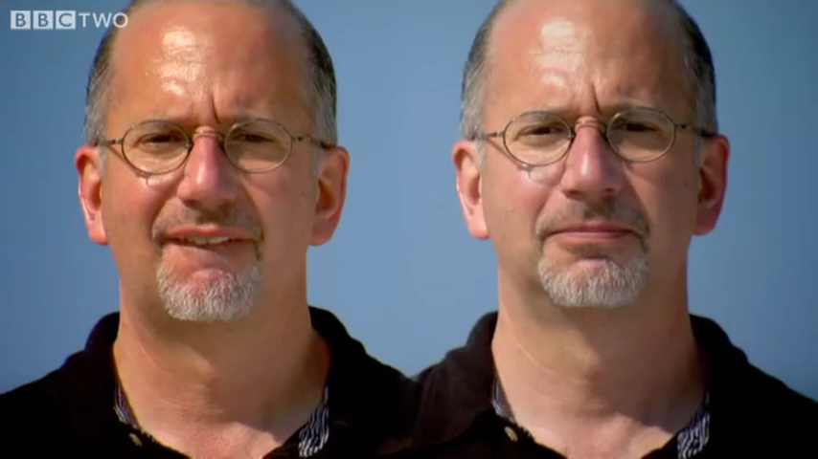
About Lip-reading
McGurk Effect
Notes:
State : continuous -> discrete (0~499)

Slide 5
Application
Enhancing Speech recognition
Audio-visual data fusion
Visual Password
Silent speech interface
Forensic video analysis
Notes:
State : continuous -> discrete (0~499)

Slide 6

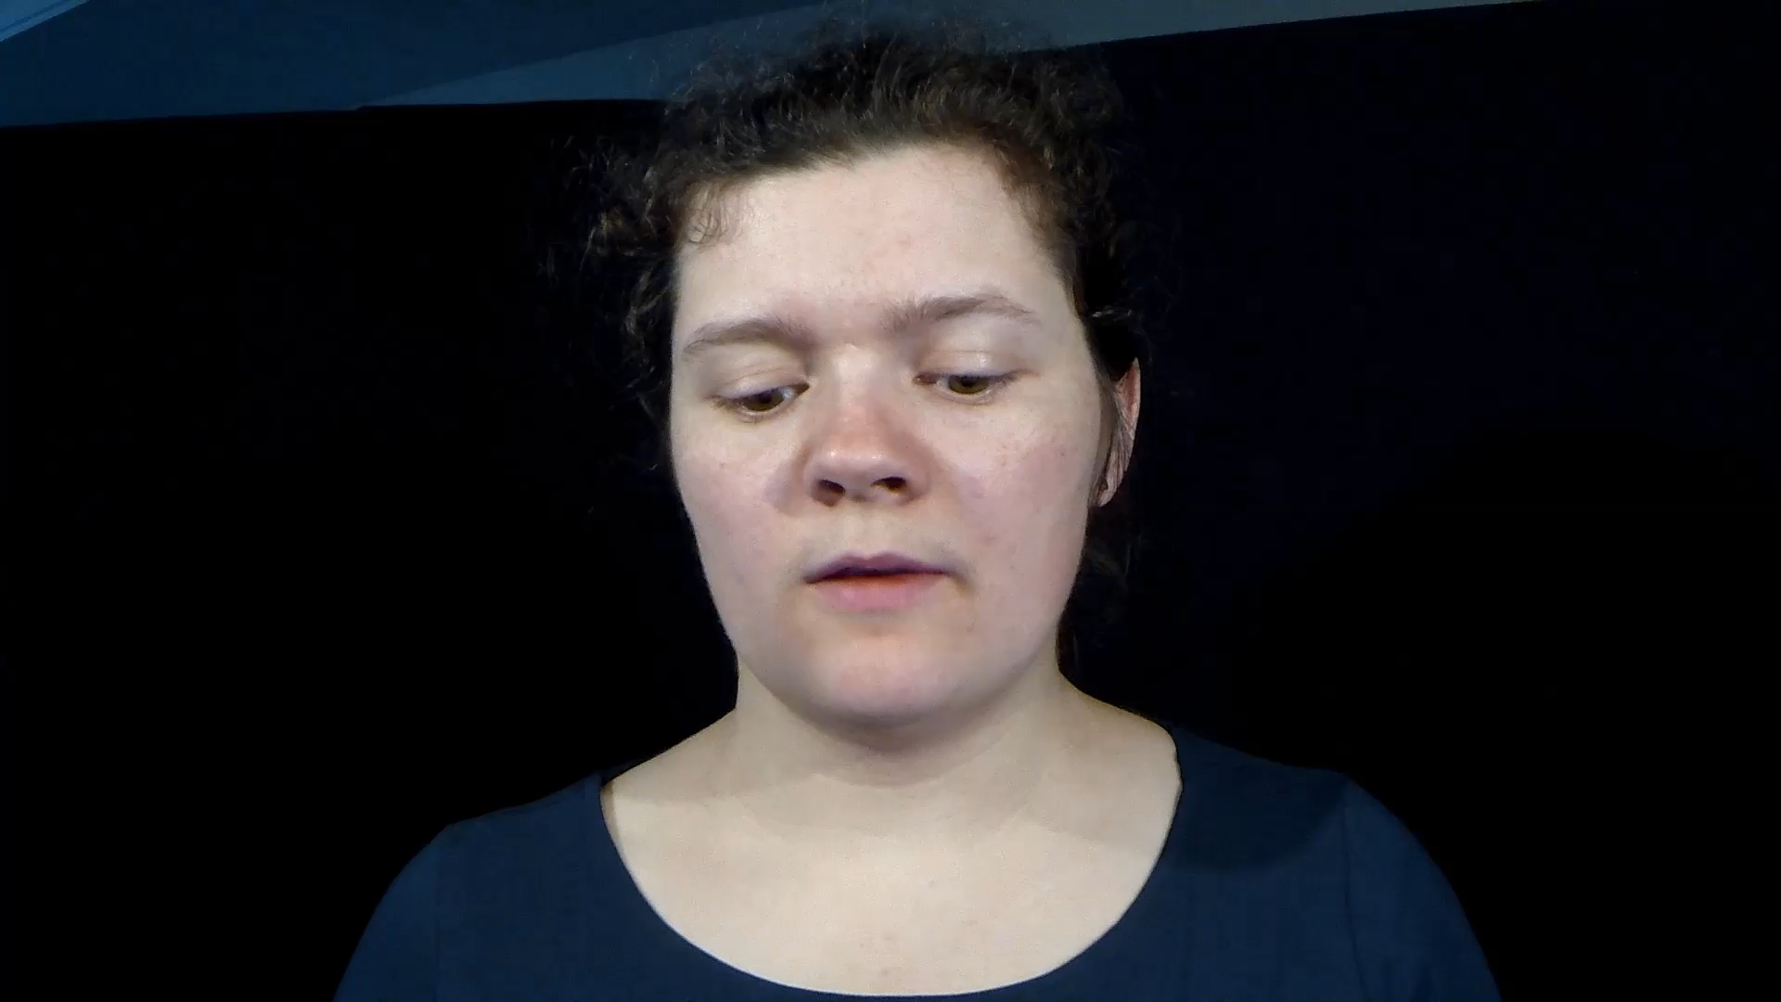
Quiz
Q) What is she saying?
See you
2. Thank you
3. Excuse me
4. Goodbye
5. Hello
Notes:
State : continuous -> discrete (0~499)

Slide 7
Quiz
Q) What is she saying?
See you
2. Thank you
3. Excuse me
4. Goodbye
5. Hello
Notes:
State : continuous -> discrete (0~499)

Slide 8
Task and Method
VSR task
Input: Sequence of lip images
Output: Text
Goal: get state-of-the-art accuracy
Method in VSR
Data pre-processing: Lip tracking and ROI(Region of Interest) extraction
Extracting visual features for various people
Classification
Notes:
State : continuous -> discrete (0~499)

Slide 9
Previous Work
Focused on feature extraction (ex. component analysis)
Deep autoencoder
Feature extraction by using deep autoencoder
CNN (Convolutional Neural Network)
Feature extraction by CNN
LSTM (Long Short Term Memory)
End-to-end learning with Neural Network, LSTM
WAND, Michael, et al. “Lipreading with long short-term memory”, IEEE International Conference on Acoustics, Speech and Signal Processing
Notes:
State : continuous -> discrete (0~499)

Slide 10
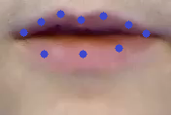
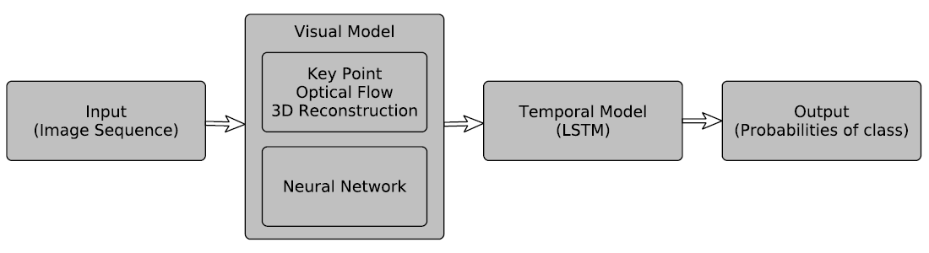
Our Approach
Neural Network approach
CNN: for feature extraction
DNN (Deep Neural Network): learning with basic neural network
RNN or LSTM: learning for the sequential data
With Visual Model
Key Point, Optical flow
3D Reconstruction
Notes:
State : continuous -> discrete (0~499)

Slide 11
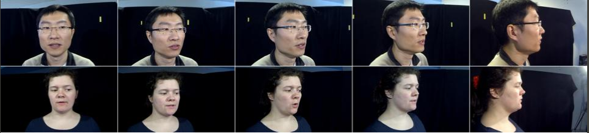

Dataset – OULUVS2
OULUVS2: A Multi-View AudioVisual DataBase
http://ouluvs2.cse.oulu.fi/index.html
ACCV2016 WORKSHOP: Multi-View Lip-Reading/Audio-Visual Challenges
Notes:
State : continuous -> discrete (0~499)

Slide 12
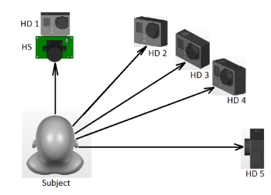
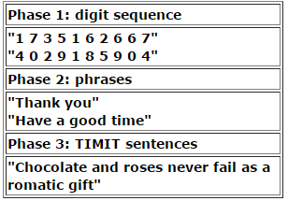
Dataset – OULUVS2
Recordings
video recordings from 52 subjects
from five different views simultaneously
Contents
digits : randomly generated ten fixed digit sequences.
phrases: ten daily-use short English phrases
TIMIT sentence: five randomly selected TIMIT sentences
Notes:
State : continuous -> discrete (0~499)

Slide 13
Q&A

Slide 14
End of Presentation

